Slide 1




Kazakhstan population
Data Сollection, Wrangling, Analysis and Visualization
Final project
Rakhmetolla Dauren Zamanbek Adilkhan Sanatbek Olzhas

Slide 2


Project Description
1. Data Collection 2. Data Visualization 3. Data Analytics

Slide 3


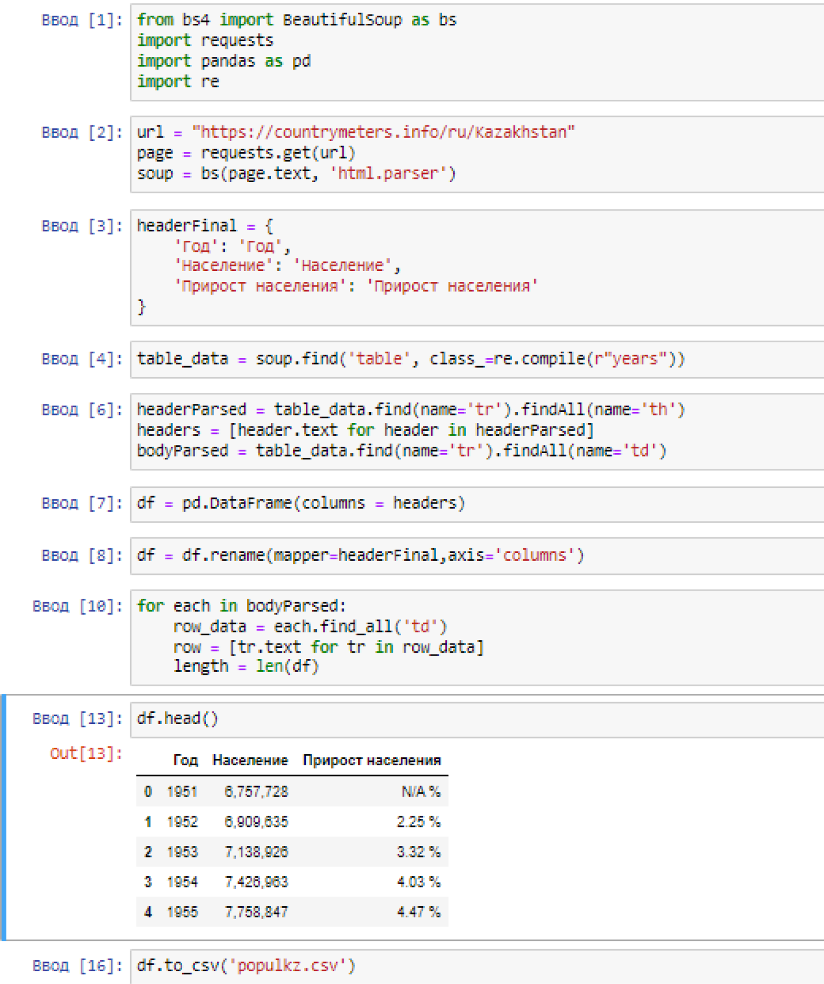

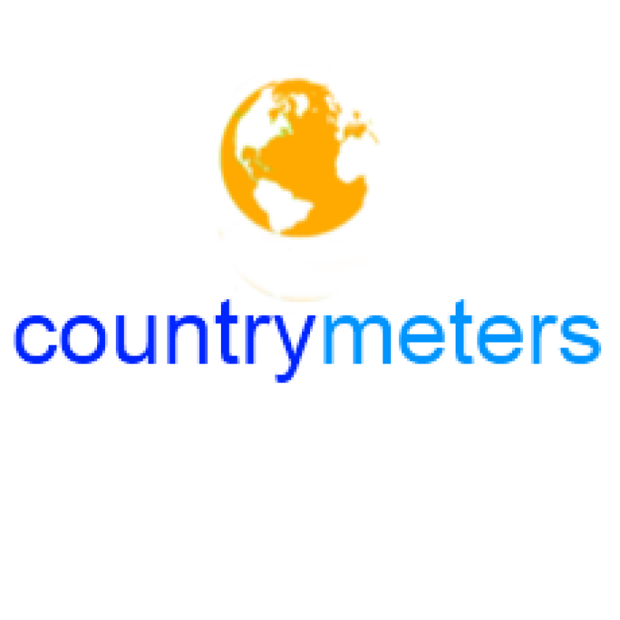
Data collection
Population data was taken from the Country Meters source

Slide 4
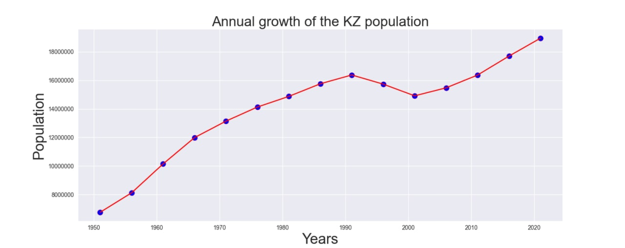
Data visualization

Slide 5
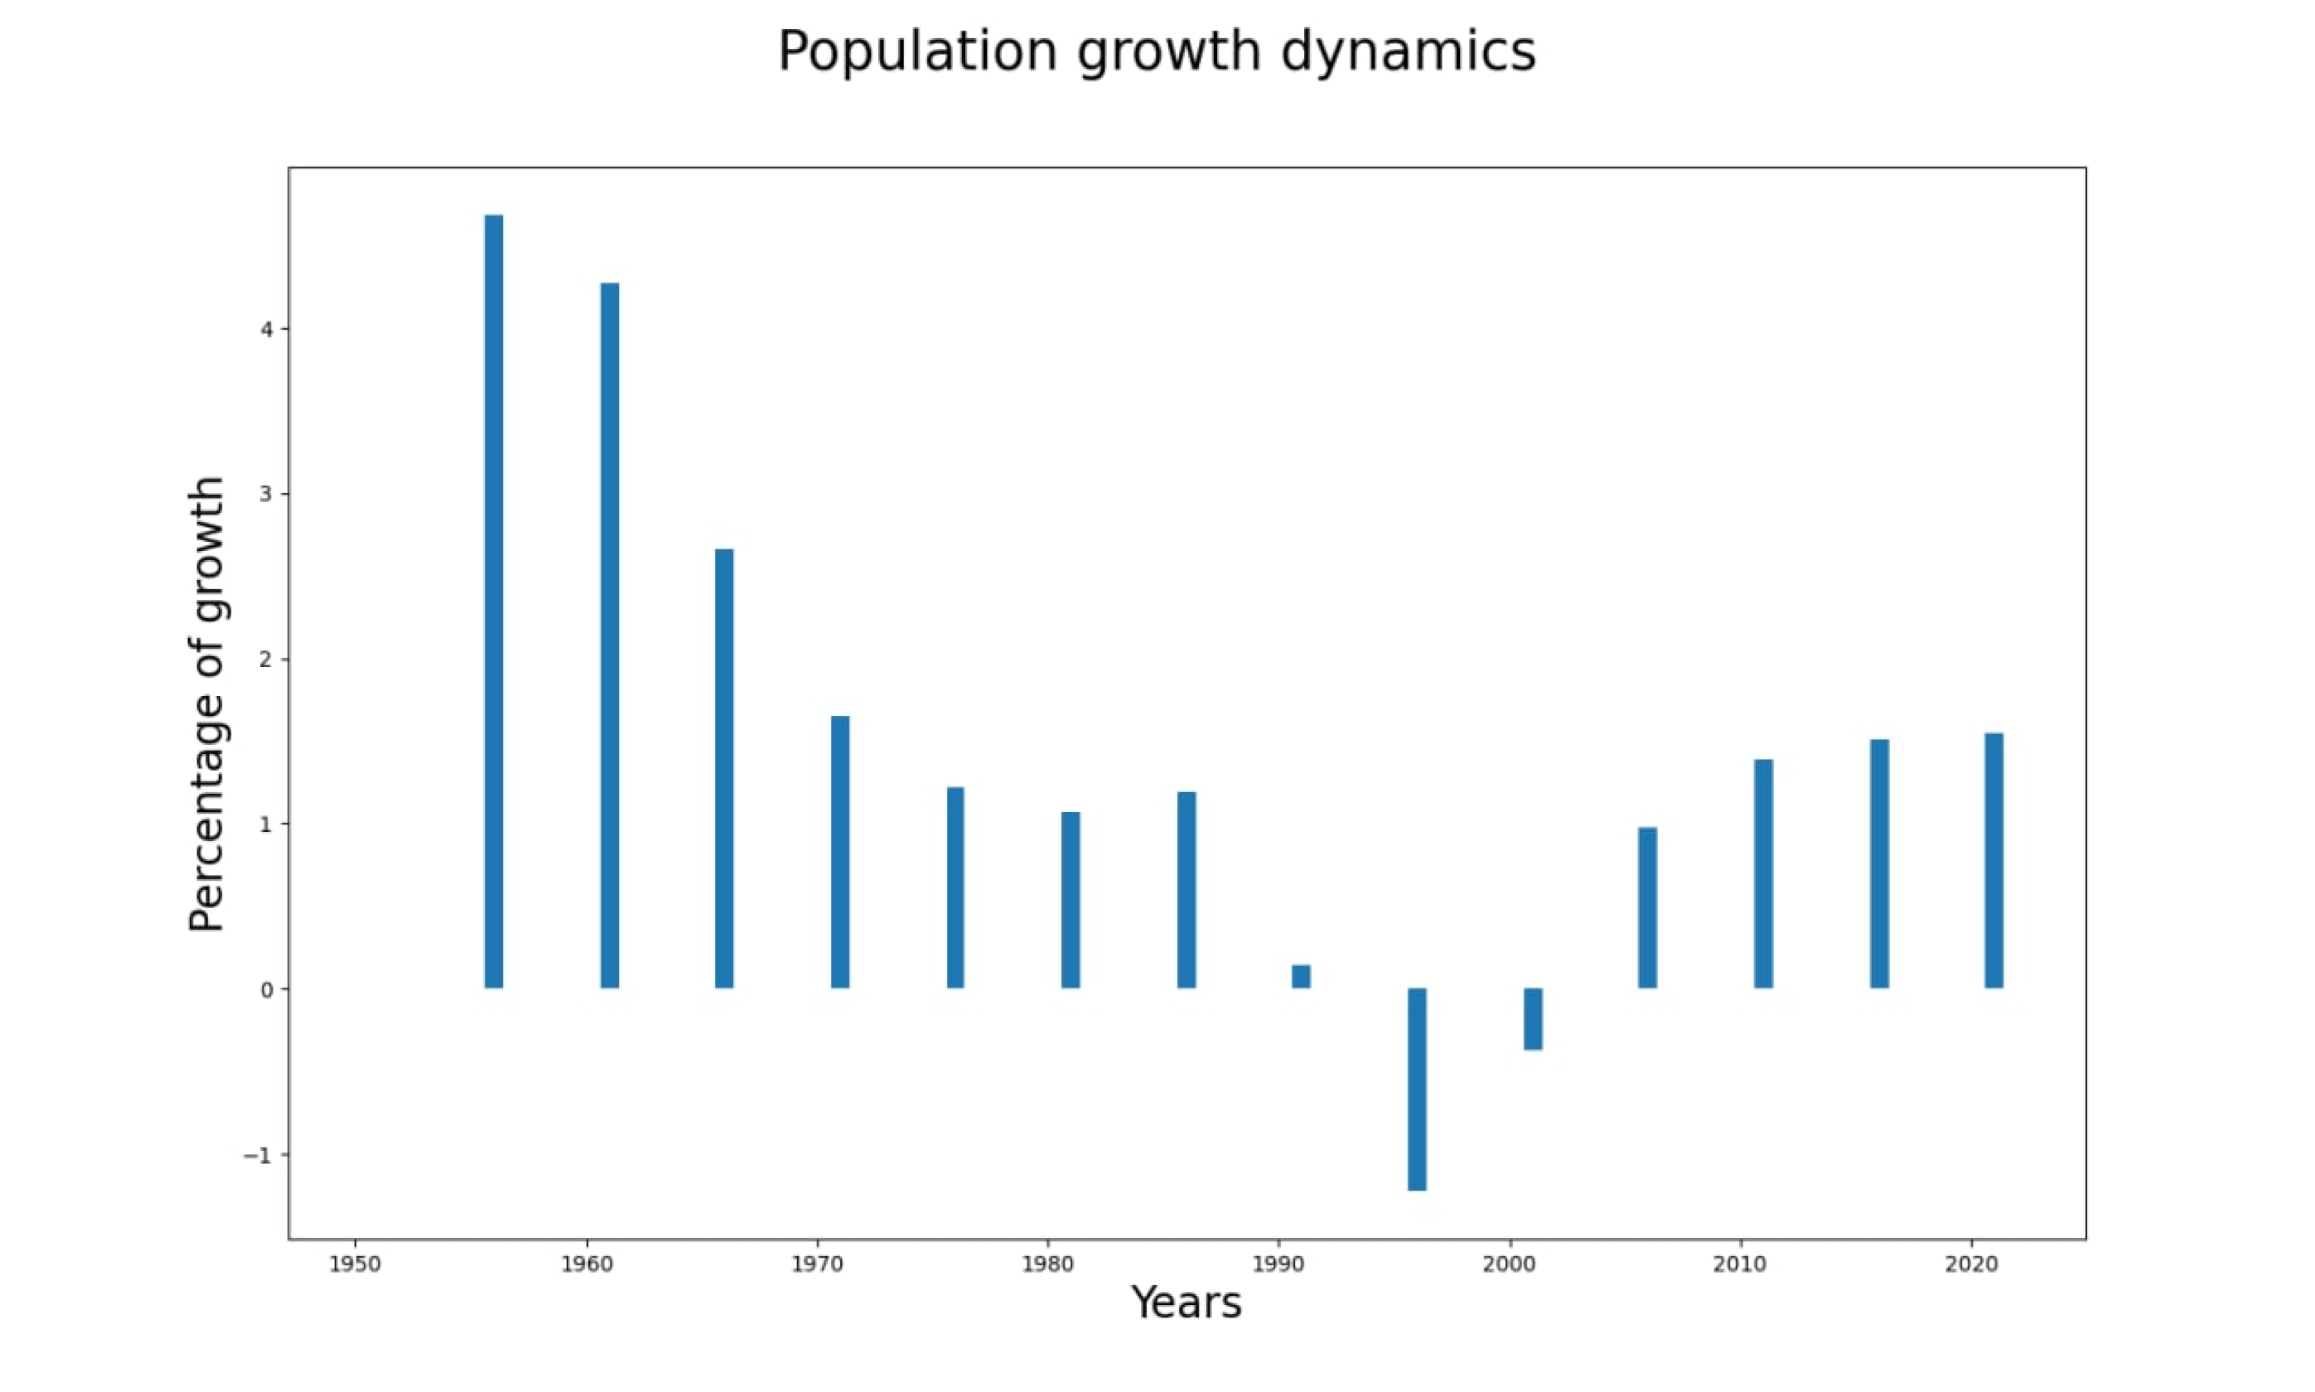
Data visualization pt.2

Slide 6

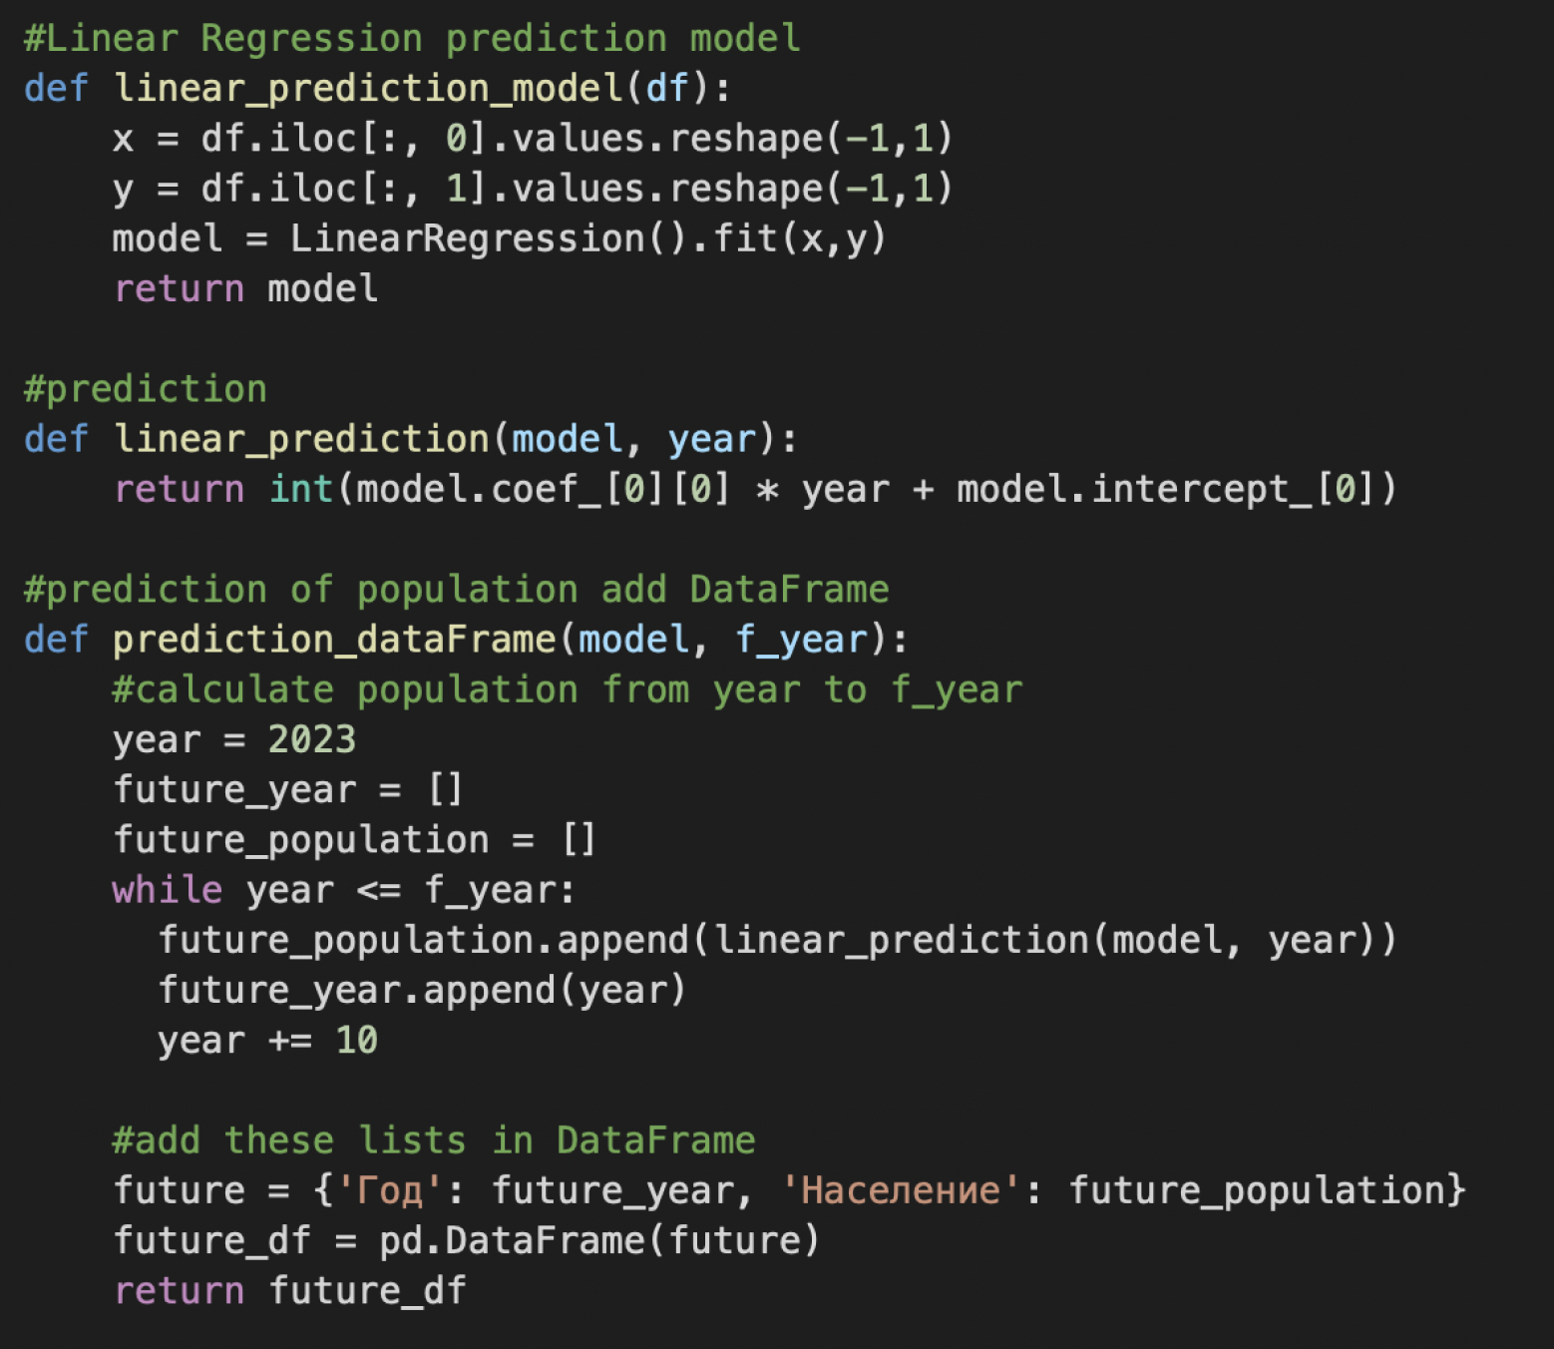
Data Analytics
This linear_prediction function simply takes the coefficient and intercept from the model and uses ‘y=mx+c’ to derive the predicted population. And the prediction_dataFrame function calculates the previous year's predictions and adds the data frame.

Slide 7
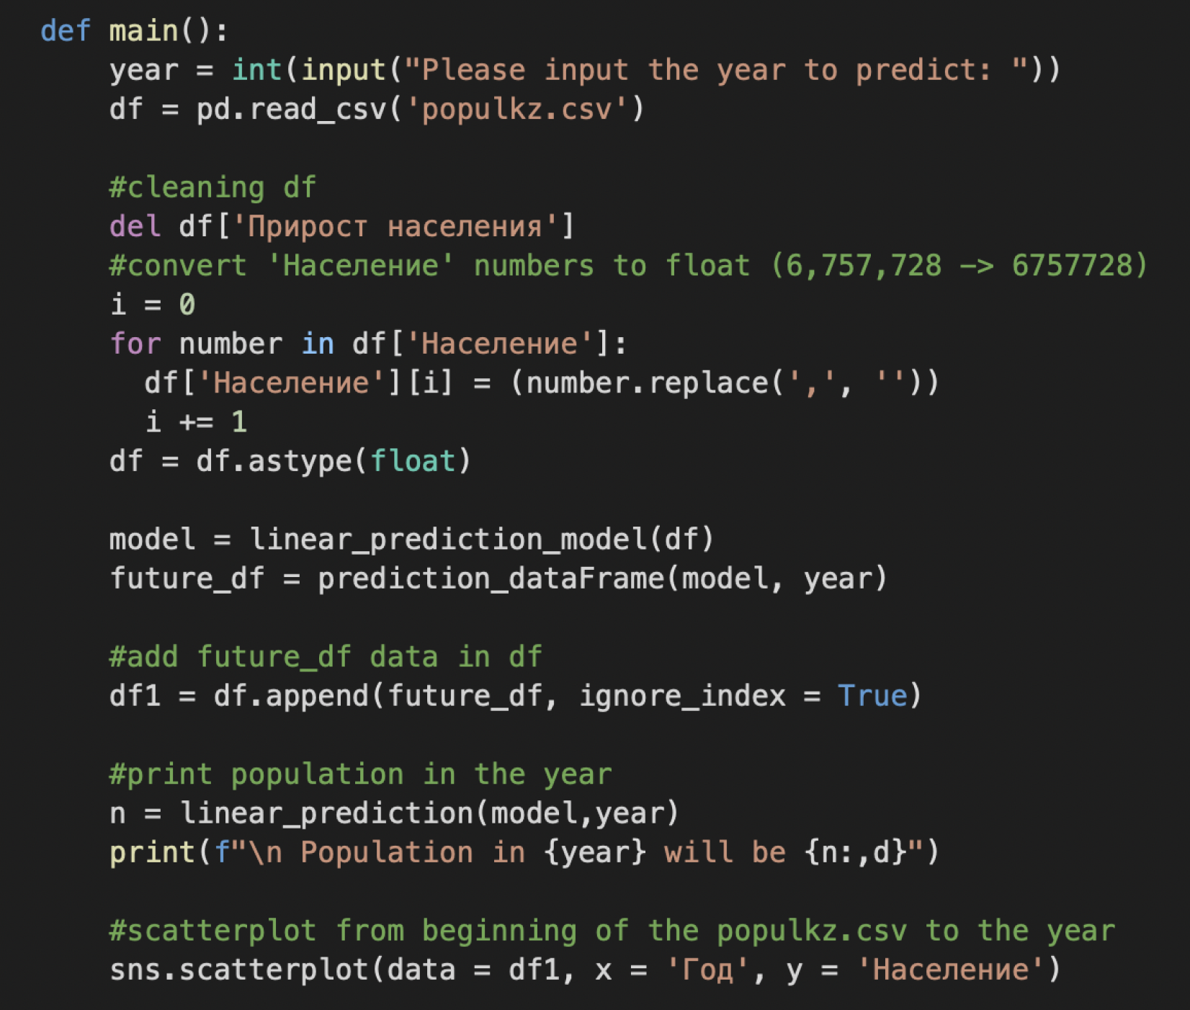
Data Analytics pt.2
Added the main function

Slide 8
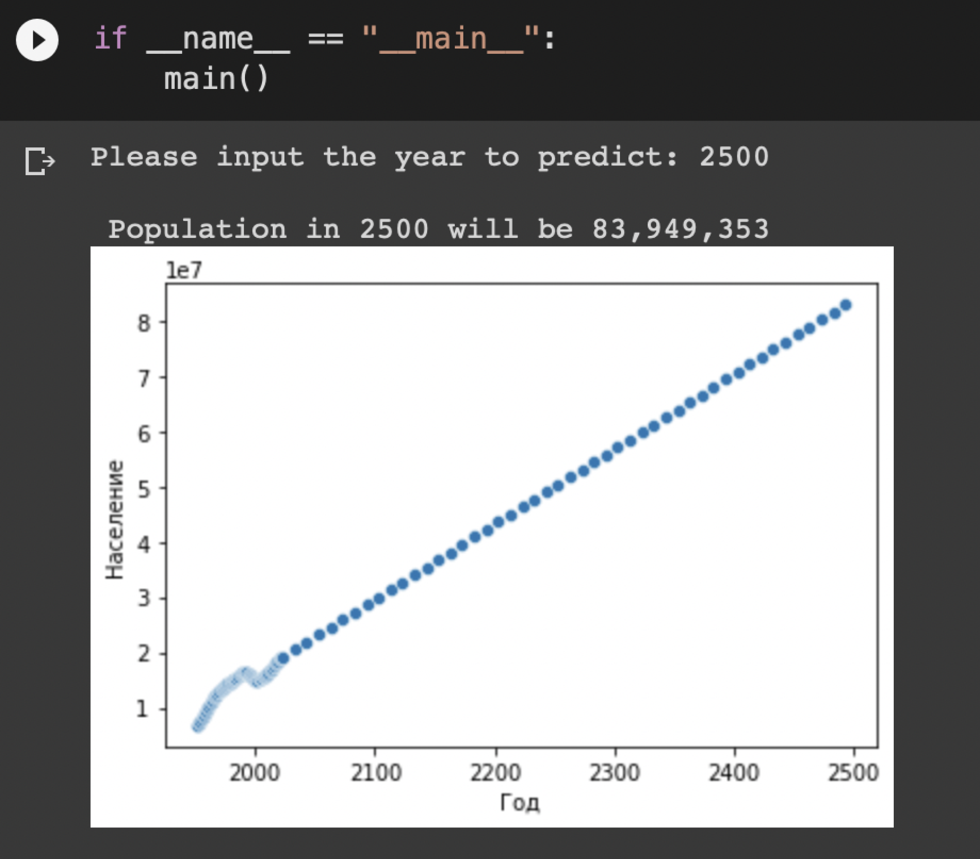
Data Analytics Pt.3
Result

Slide 9






Thank you for attention!

